Slide 1
GROWING IN WHAT MATTERS MOST

Slide 2
WHO IS THE HARDEST PERSON TO LEAD?

Slide 3

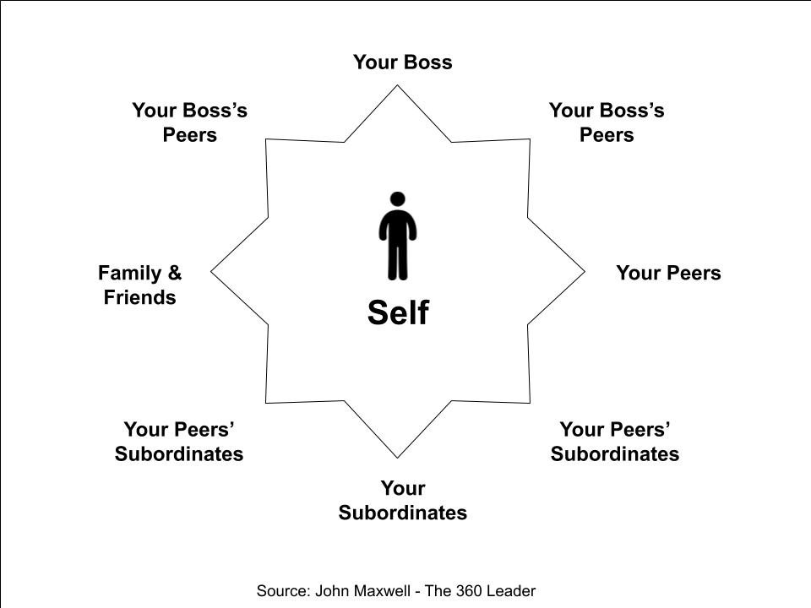

Slide 4
1 Samuel 30:6
And David was greatly distressed; for the people spake of stoning him, because the soul of all the people was grieved, every man for his sons and for his daughters: but David encouraged himself in the Lord his God.

Slide 5
I need to lead myself before I can lead anyone else.

Slide 6
Why do people lack a focus on self leadership?

Slide 7
What are you doing to grow YOU?

Slide 8
How do you know if you are growing in what is most important?

Slide 9
How did Jesus grow?

Slide 10
Luke 2:52
“And Jesus grew in wisdom and stature, and in favor with God and man.”

Slide 11
God wants you to GROW

Slide 12
God wants you to GROW RIGHT

Slide 13
1. HOW AM I GOING TO GROW MY MIND?
(WISDOM)

Slide 14
2. HOW AM I GOING TO GROW PHYSICALLY?
(STATURE)

Slide 15
3. HOW AM I GOING TO GROW IN MY RELATIONSHIP WITH GOD?
(FAVOR WITH GOD)

Slide 16
4. HOW AM I GOING TO GROW IN MY RELATIONSHIP WITH OTHERS?
(FAVOR WITH MAN)

Slide 17
5. HOW AM I GOING TO GROW IN MY FINANCES?

Slide 18
Matthew‬ ‭6:21‬ ‭NIV
‬‬ “For where your treasure is, there your heart will be also.”

